Slide 1
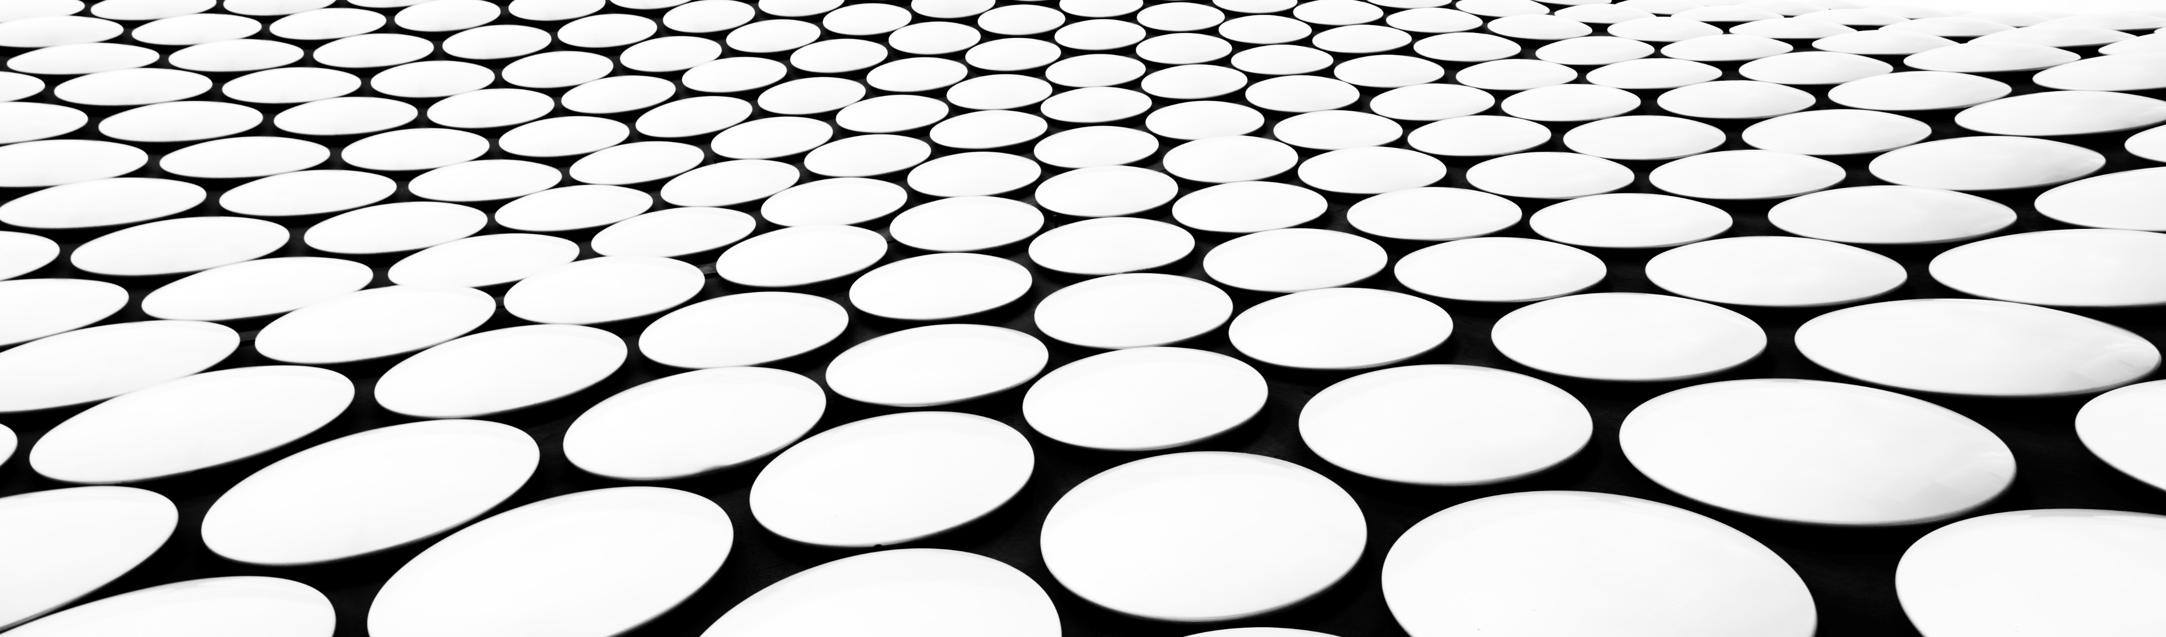
Name Janathul firdhous.A
Reg no 24900115
Dept CSE(1 st year)
Course Principles of chemistry in engineering
Slot 4I2-1

Slide 2
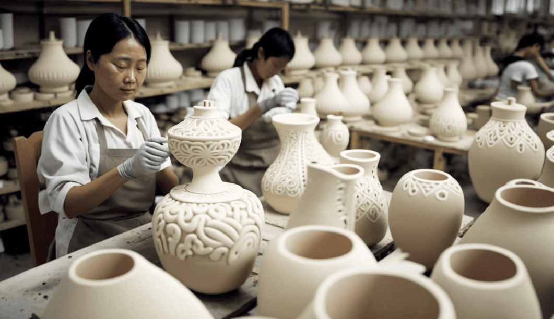
1.Explain the manufacturing of white pottery and mention their uses.
Manufacturing of White–Pottery
It involves the following steps
1.Preparation of the body of the ware:
The raw materials (Kaolin and feldspar) are finely powdered and mixed with suitable quantity of water.The desired shape is produced by any of the forming processes described earlier (mouding (or) throwing on a potter’s wheel or jiggering).Next,the article thus produced is carefully dried and fired in a biscuit oven (called biscuit firing) to get porous-ware called “bisque”.

Slide 3
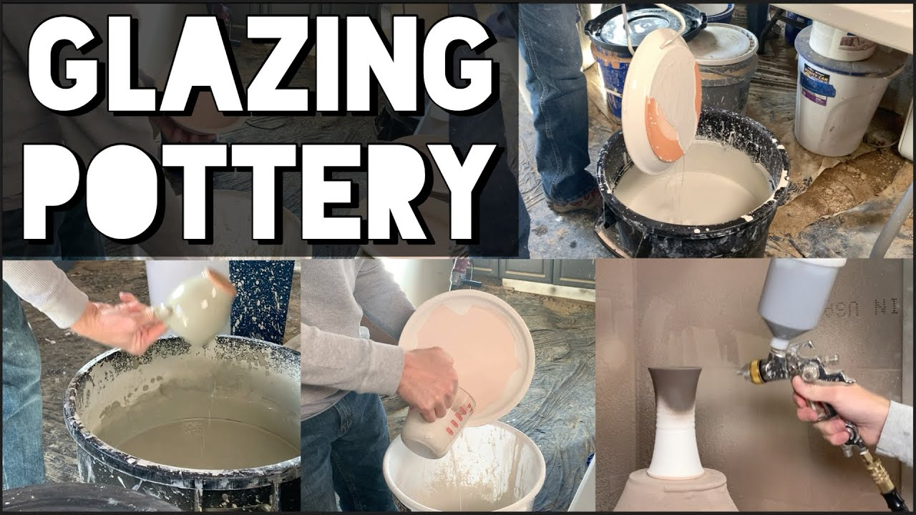
2.Glazing
In order to get water-tight article,the porous article is coated with a glaze.The constituents of the glaze (viz,quarts,feldspar and a little boric oxide and little lead oxide) are finely powdered and mixed with water to form a slurry (“slip”),The “bisque” is dipped into the “slip” and fired again until the glaze fuses and produces a smooth and glassy surface.

Slide 4
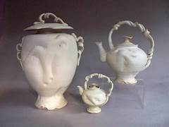
3.Decoration
In order to decorate the article,the desired design is painted on the body of the white ware before glazing,it is known as “under-glazed”design.On the other hand,the decorative design may be painted upon the glaze followed by another firing,it is known as”over-glazed”design .Metallic oxided like chromium oxide,cobalt oxide,manganese oxide are used as pigment for “under –glazed where as coloured glasses are used for “over-glazed” designs”

Slide 5
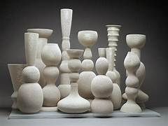
Uses
They are used in electrical sparkplugs ,crucibles,electrical insulators,laboratory equipments and decorative pottery

Slide 6
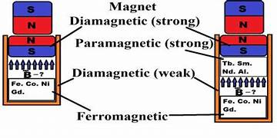
2.What is diamagnetism? List out the difference between soft and hard magnetic material with example.
Diamagnetism is the property of materials that are repelled by a magnetic field; an applied magnetic field creates an induced magnetic field in them in the opposite direction, causing a repulsive force.

Slide 7
Difference between soft and hard magnetic materials
Soft magnetic materials | Hard magnetic materials
The magnetic materials can be easily magnetize and demagnetize | The magnetic materials can not be easily magnetize and demagnetize
They have high permeability | They have low permeability
Magnetic energy stored is not high | Magnetic energy stored is high
Low hysteresis loss due to small hystereris loop area | Large hysteresis loss due to large hystereris loop area
Coercivity and retentivity are small | Coercivity and retentivity are large
The eddy current loss is small due to its high resistivity | The eddy current high is small due to its low resistivity
The domain walls are easy to move | The movement of domain wall must be prevented

Slide 8
They are used in electric motor ,generators transformers,relays,telephone receivers,radar | They are used in loud speakers and electrical measuring instruments.
Example: iron-silicon alloys, nickel iron alloy- and iron | Example: Alloys composed of iron, cobalt and aluminum

Slide 9
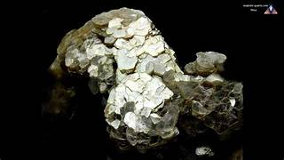
3.Define Mica its properties,advantages,diaadvantages,and applications.
Mica
Mica is an inorganic material made up of silicates of aluminium and silicates of potash soda and magnesium .It is a crystalline material in nature and can be easily divided into a number of thin sheets

Slide 10
Properties
1.Mica is an transparent material and a very thin sheet.
2.It is optically flat,non-flammable material
3.It is not affected by atmospheric condition
4.It can withstand with temperature upto 1000*C.
5.It has high thermal stability and low heat conductivity.

Slide 11
Advantages
1.It reduces heat transfer
2.It is a heat resistant material
3.It is crystalline stable
4.It is used as a cosmetic products
5.It improves friction
Disadvantages
1.Mica mining causes deforestation, soil erosion, and water pollution.
2.Exposure to mica dust can lead to respiratory problems and lung diseases.
3.Mica mining often involves child labor and unsafe working conditions.
4.Mica extraction is costly and requires significant manual labor.
5.Mica is brittle and prone to breaking or chipping during handling.

Slide 12
Applications
1, It is used for many medical field to treat the disease occurs at kidney and liver
2. It is used as a pigment in paints
3. It is suitable for all skin types and does not have any side effects
4. They are highly used in electrical appliances like control devices,heating devices ,neon lights and other lighting equipment
5. It is used as filler in cements and asphalt and act as an insulation material in electric cables.
6. It can help to fully insulate semiconductors from their chassis

Slide 13


